Slide 1
Emotion Analysis and Detection in Mental Health Using Natural Language Processing Techniques
DSCI 6004-1: Natural Language Processing
Name: S Ganga Vamsik
P Peda Brahmendra
K Jithendra Prasad

Slide 2
Introduction
The intersection of Natural Language Processing (NLP) and mental health is a rapidly growing field, with significant potential to improve emotional understanding through technology.
This project uses NLP techniques to analyze and classify emotions within mental health-related conversations.
It focuses on NLP-based framework that processes and interprets user-generated text data, specifically targeting emotional expressions associated with mental health issues.
This initiative aims to provide insights that can enhance mental health support and interventions using different NLP models.

Slide 3
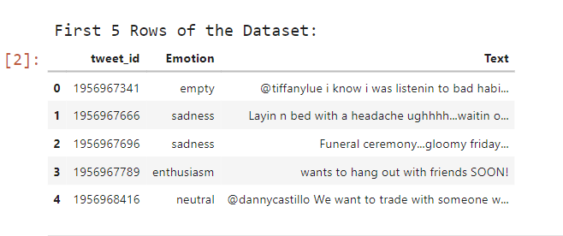
Dataset Overview
NLP Mental Health Conversations (Emotion Detection NLP Mental Health): This dataset comprises real-world conversations about mental health on social media , allowing us to understand emotional expressions within various contexts.
Dataset Overview

Slide 4
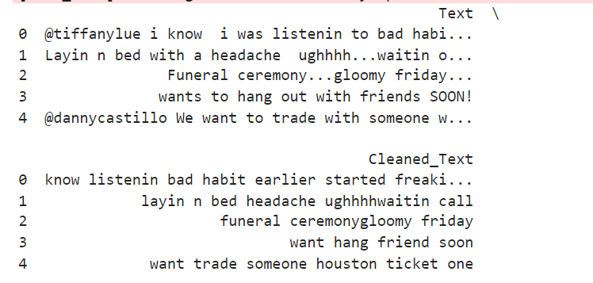
Text Preprocessing
Text Cleaning: Convert text to lowercase, remove URLs, mentions, hashtags, punctuation, and numbers, then tokenize.
Stopword Removal: Exclude common stop words and lemmatize words using WordNetLemmatizer to reduce inflection.
Dataset Processing: Apply preprocessing on dataset text to create a cleaned column for further analysis

Slide 5
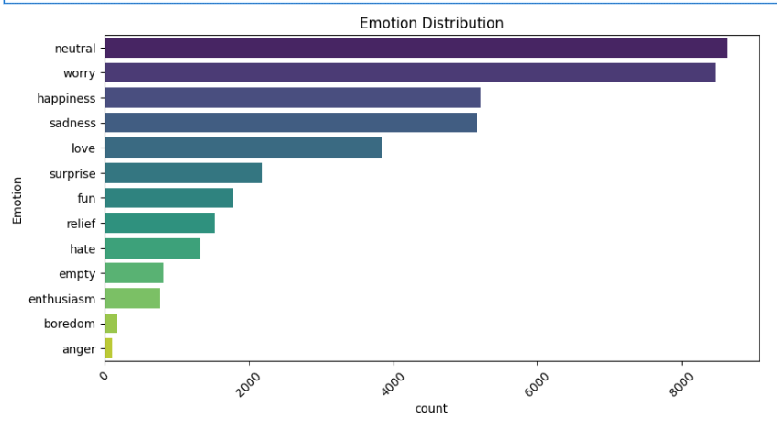
Emotion Distribution

Slide 6
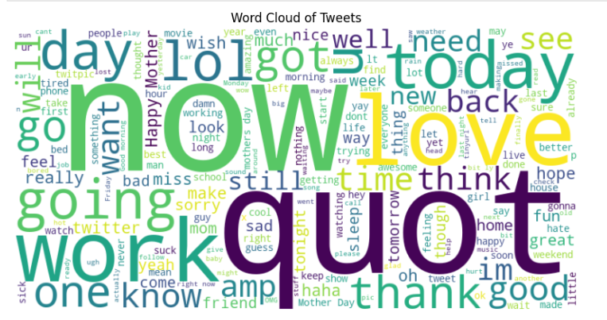
Conversations Overview

Slide 7
Methodology:
Label Encoding: Encodes categorical emotion labels into numerical values using LabelEncoder.
Data Splitting: Splits the data into training (80%), validation (10%), and test (10%) sets, ensuring class balance with stratify.
Count Vectorization: Converts text data into numerical vectors using CountVectorizer, limiting features to 10,000.
Tensor Conversion: Converts the vectorized text and encoded labels into PyTorch tensors for use in deep learning.

Slide 8
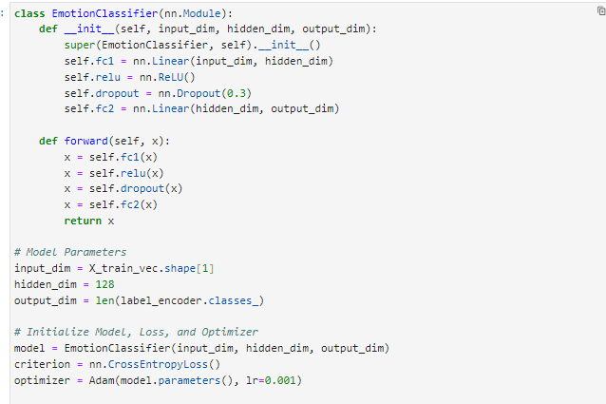
Model 1: EmotionClassifier
A simple feedforward neural network with two fully connected layers, ReLU activation, dropout for regularization, and 13 output classes for emotion classification.

Slide 9
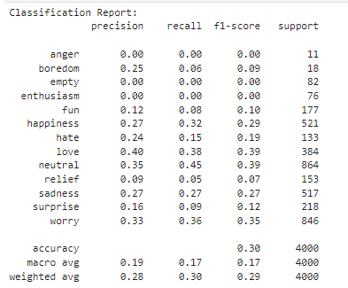
Model 1: Performance
The classification report shows low precision, recall, and F1-scores across most emotions, with overall accuracy of 30%, indicating room for improvement in the model's performance and class balance.

Slide 10
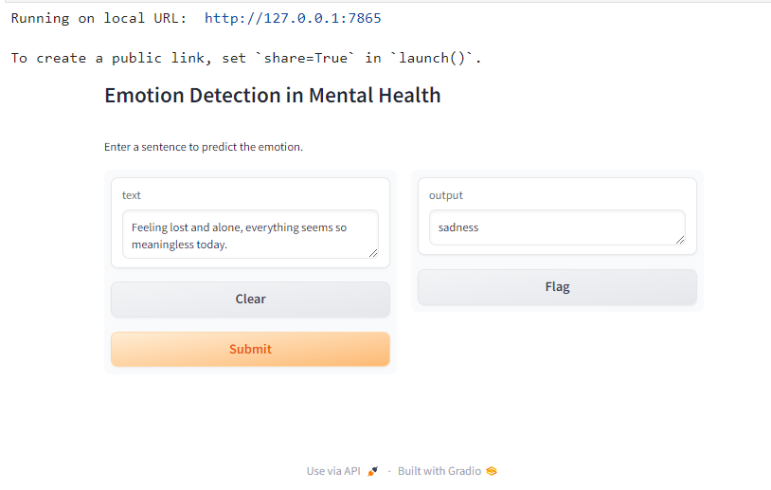
Model 1: Deployment

Slide 11
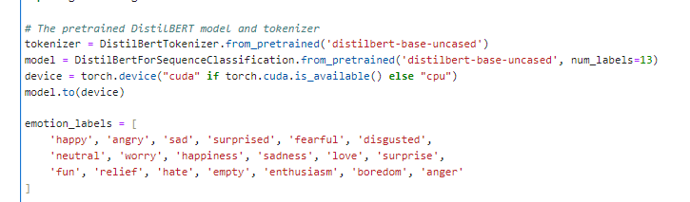
Model 2: DistilBERT
The DistilBERT model is a lightweight, distilled version of BERT, offering faster inference while maintaining high accuracy.
It is ideal for real-time emotion prediction, leveraging transformer-based embeddings for nuanced text understanding.

Slide 12
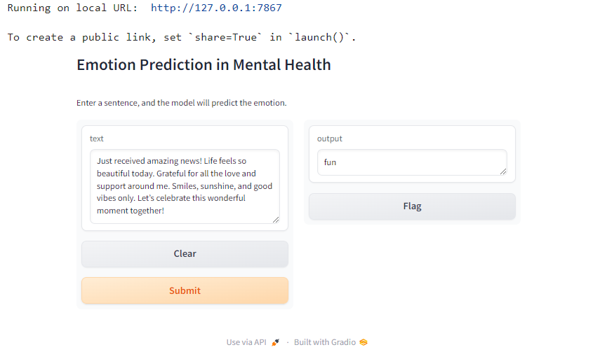
Model 2: DistilBERT Deployment

Slide 13
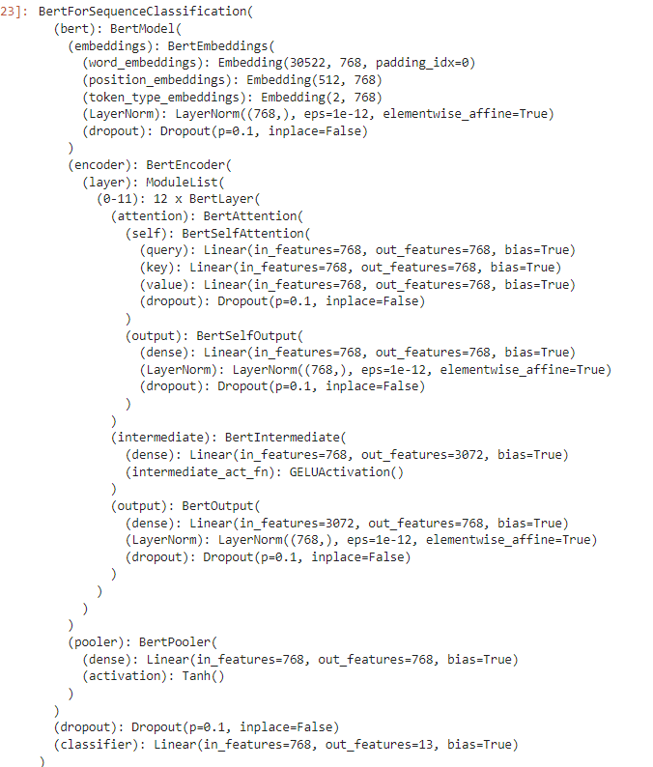
Model 3: BERT Model
The BertForSequenceClassification model is built upon the BERT architecture, which uses 12 transformer layers for deep contextual understanding of text.
It includes a classification head comprising a dropout layer and a fully connected layer for 13 output classes, ideal for emotion prediction.

Slide 14
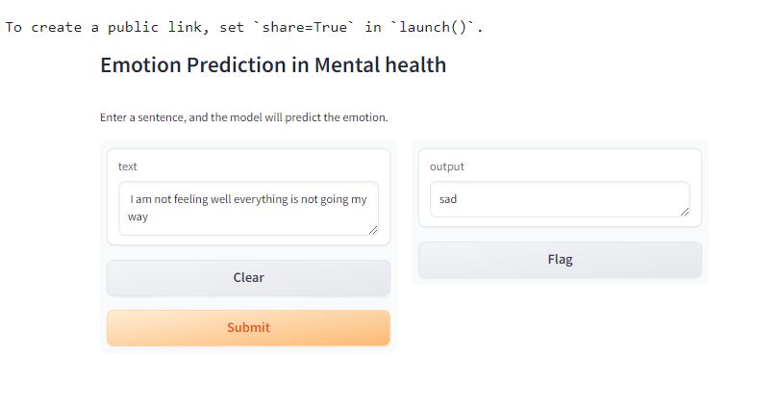
Model 3: BERT Deployment

